Slide 1
A Minor Project On
Event Organizing System(EOS)
A Digital platform for Organizing Events
Team Members
Sameer Bhatt | Mamata Pant | Ravi Bhatt | Roshan Bhatt
Under the Guidance of
Late Er. Bhim Bdr Pun
Far Western University
School of Engineering
Kanchanpur, Nepal

Slide 2
Table of contents
01
02
03
Introduction
Objectives of EOS
Literature Review
04
05
06
Feasibility Analysis
System Requirement
Functional Requirement

Slide 3
Introduction to Event Organizing System(EOS)
EOS, our event organizing system, simplifies planning by providing seamless coordination between event hosts and participants.
With its user-friendly design, EOS allows users to effortlessly manage and book events in just a few clicks.
The system ensures real-time updates, making communication and event tracking smooth for organizers and attendees alike.
EOS caters to a variety of events, from corporate meetings to social gatherings, ensuring flexibility for all users.
Built with scalability in mind, Eventzo grows with your needs, handling multiple events and participants efficiently

Slide 4
Objectives of EOS
1. Streamline Event Management: To provide a centralized platform for managing event details, user registrations, and logistics efficiently.
2. Enhance User Experience: To offer a user-friendly interface that simplifies event creation, registration, and participation for both organizers and attendees.
3. Ensure Real-Time Communication: To enable seamless communication between event organizers and participants for updates, notifications, and event-related information.
4. Improve Resource Allocation: To optimize the use of resources like venues, materials, and personnel by automating key logistical processes.
5. Increase Event Engagement: To maximize user interaction and engagement by providing personalized event recommendations and smooth participation experiences.

Slide 5
Literature Review
Events Diversity and Purpose
Quality in Event Management
Strategic Significance of Events
Challenges of Manual Systems
Technology Solutions
Value Proposition of Online System

Slide 6
Feasibility Analysis
Operational Feasibility
Operation of the proposed system depends on its various users.
User-types:
Admin
User
Technical Feasibility
Programming language
Hardware interface
Database
Tools
Economical Feasibility
Cost-Benefit Analysis
Initial Development Costs
Operational Expenses
Revenue Streams
Financial Sustainability
Informed decision

Slide 7
System Requirements
Hardware:
Laptop/PC
Internet Connection
Backup and Storage
Software:
FrontEnd Development: HTML, CSS, JS
BackEnd Development: PHP
Operating System: Linux, Windows, Mac OS
Version control system: Git(for managing code collaboratively)

Slide 8
^{Functional Requirement}
R1: Registration
Description: To enter into this App, the user has to register first. Requirements of registration are first name, last name, username, email-id, password, confirm password, etc.
Input: User Details
Output: Filled Registration Details
Processing: User details are checked with the database. Password constraints are checked as per validation.
R2: User Login
Description: The system provides a facility to log into the system.
Input: Enter username and password
Output: User Profile Page
Processing: The system will check the input of the user, and if valid, the login is done. Otherwise, the user will be asked to re-enter the username and password.

Slide 9
R3: Select the event
Description: The user can select the event .
Input: Main event, Sub event, Enrollment number.
Output: Event selected successfully and see the details.
Processing: The system will add selected data into database.
R4: Forgot Password
Description: The user can send reset link to the email and reset the password.
Input: Email ID.
Output: Reset link to Email ID.
Processing: By reset link we can easily change the password and store in the database.

Slide 10
R4: Admin Panel
Description: The Admin can add a manager, main event, sub-event also.
Input: Main event, sub-event, manager.
Output: Add successfully in the database.
Processing: The system will add selected data into the database.

Slide 11
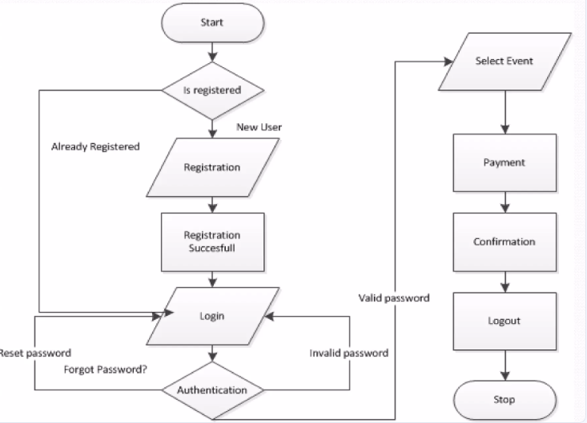
Flowchart

Slide 12
Snapshot of the Project

